Slide 1
ЯECERT
Assisting in certifications and recertifications

Slide 2
TARGET USERS:
Any individual user that wishes to keep track of their certifications as well as receiving reminders of when to they need to recertify.

Slide 3
CURRENT ISSUE:
REQUIREMENTS FOR CERTIFICATIONS/ RECERTIFICATIONS
DEADLINES
ORGANIZATIONAL PROBLEMS

Slide 4
APPLICATION :
GIVES THE USER THE NECESSARY RESOURCES TO AQUIRE THE CERT
ALERTS THE USERS ( 180, 90, 60, 30-0)
ALLOWS USERS TO ADD, DELETE OR EDIT CERTIFICATIONS

Slide 5
HOW :
PROFILE DATABASES
USING INDIVIDUAL PROFILES
LOW LEVEL ENCRYPTION

Slide 6
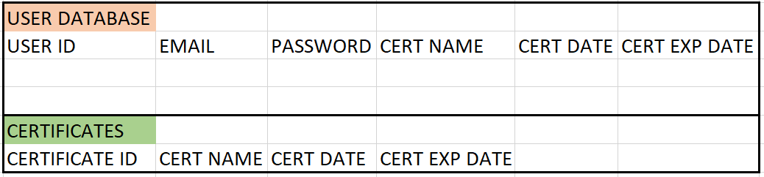
LOCAL DATABASE LAYOUTS
The User Database will have access to the users certificates and be able to add, delete, and edit certificates.
The Certificate Database will contain the certificate information for the user to implement.

Slide 7
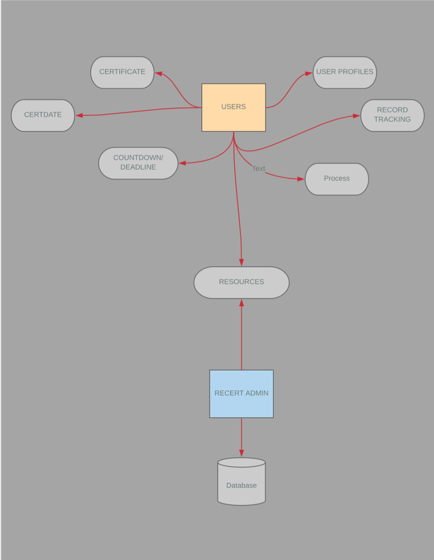
Entity Relationship diagram:

Slide 8
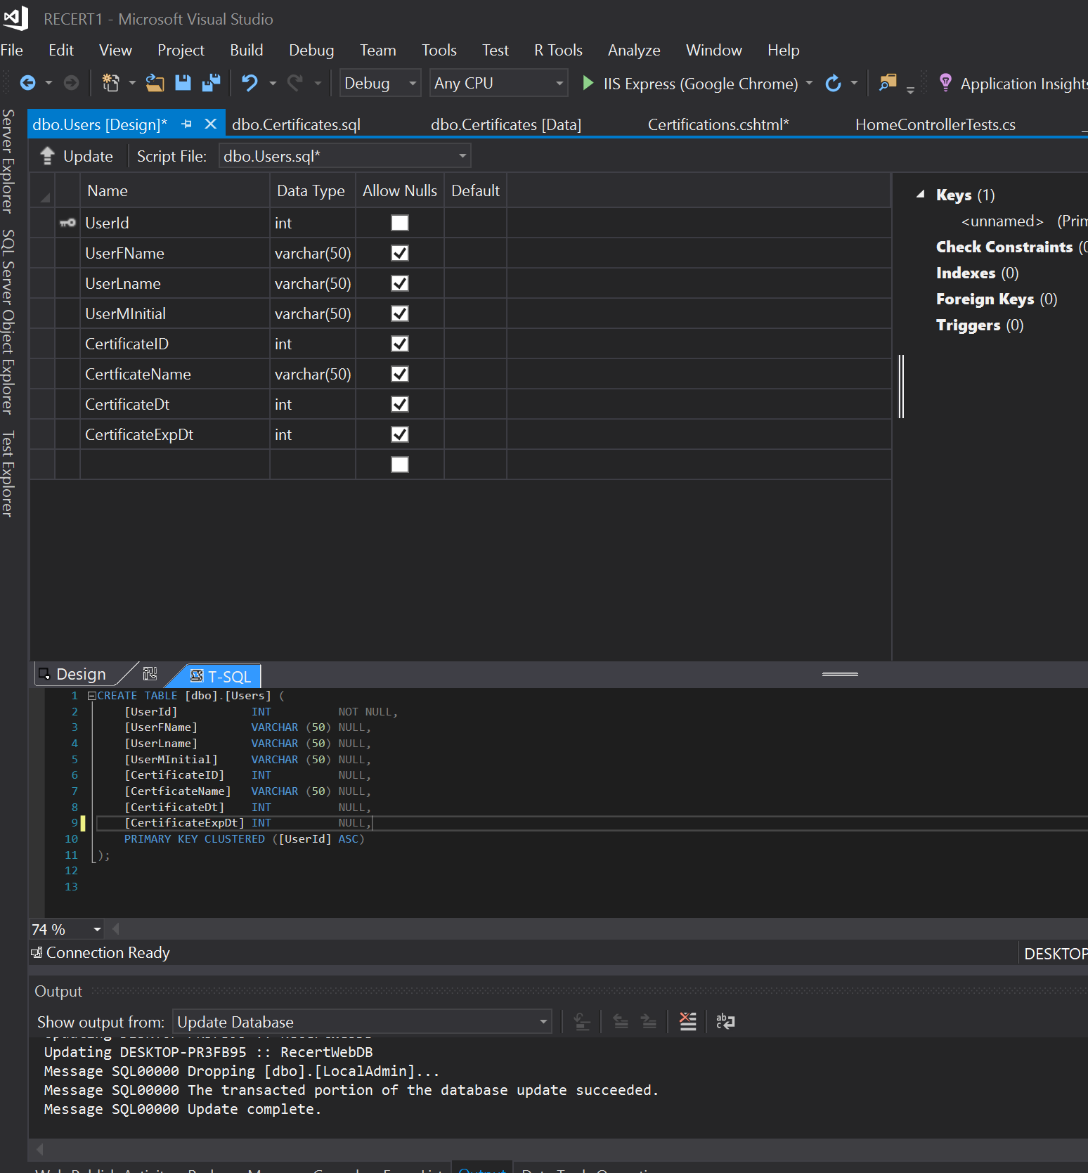
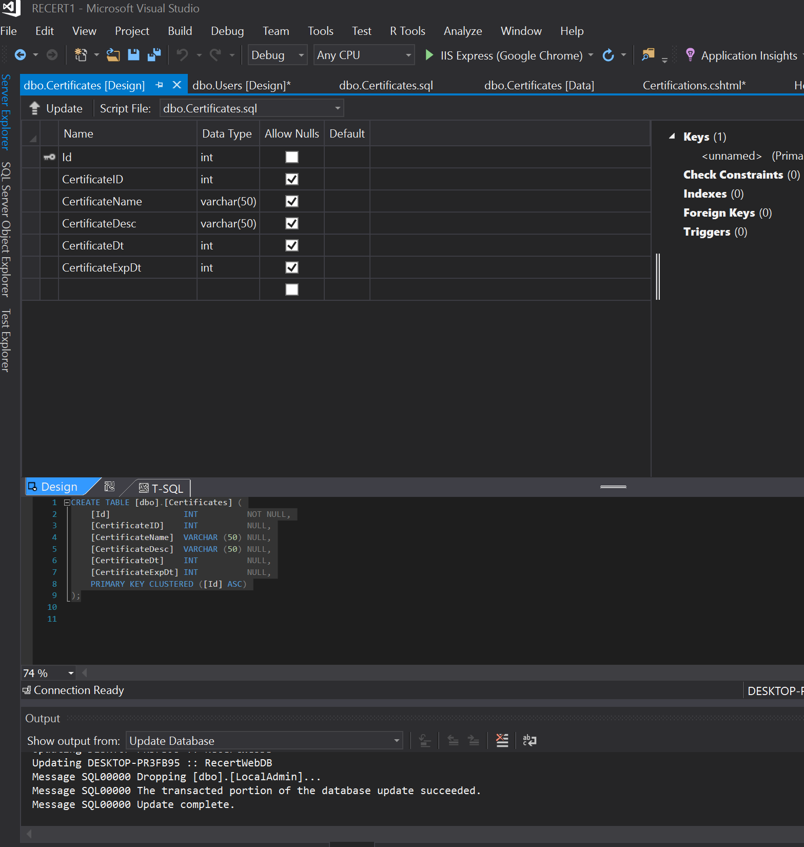
DATABASE TABLES :

Slide 9
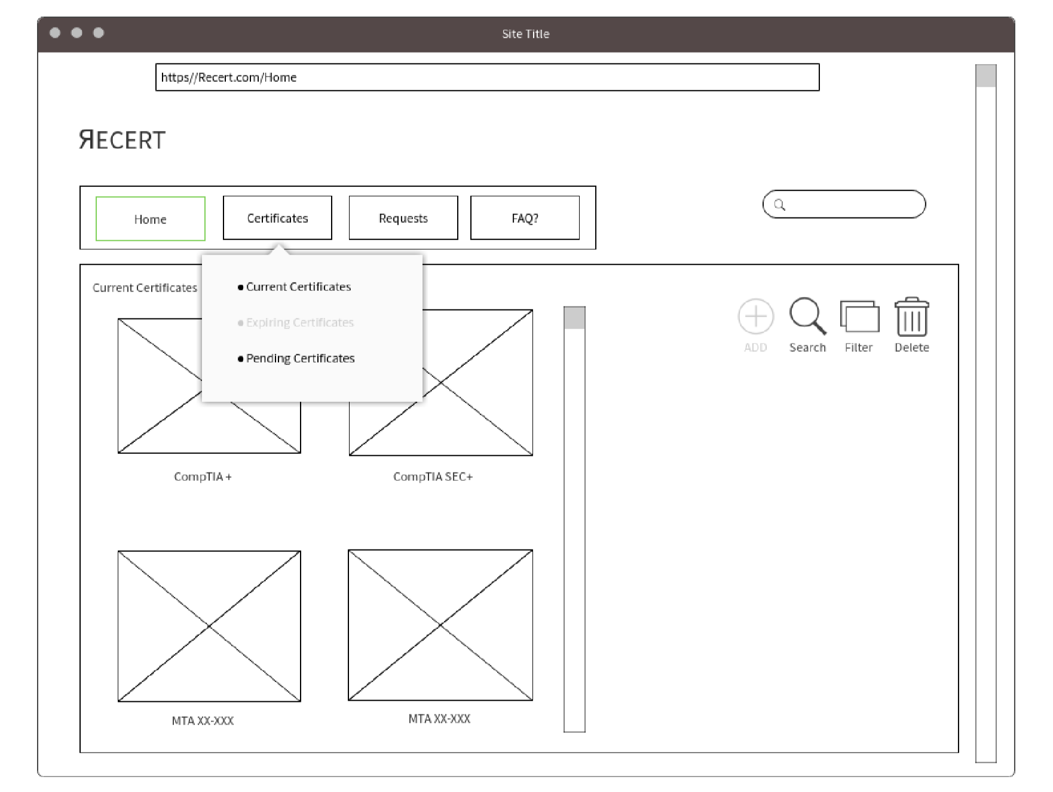
WIREFRAME SAMPLE
The User will be able to navigate through the site with ease.
Search Feature
Easily upload, Delete and Update current Certifications
User will be able to Request resources and information on future certifications

Slide 10
GitHub
https://github.com/jobmejia

Slide 11
?QUESTIONS?
???

